Slide 1
Introducing the “Particle Players”
Neutrino
υ_{μ−}
Leptonic “Little Neutral One”
Proton
p⁺
Neutron
n⁰
Quarky & Positive
Quarky & Neutral
Electron
e⁻
Leptonic & Negative
muon
μ⁻
Electron’s Heavier Unstable Cousin

Slide 2

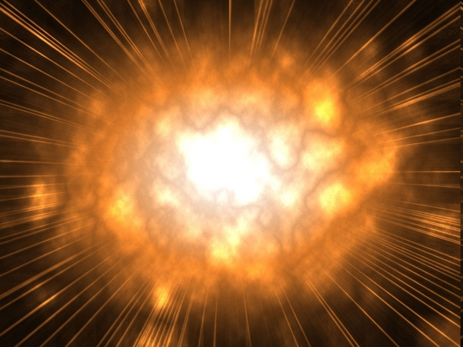
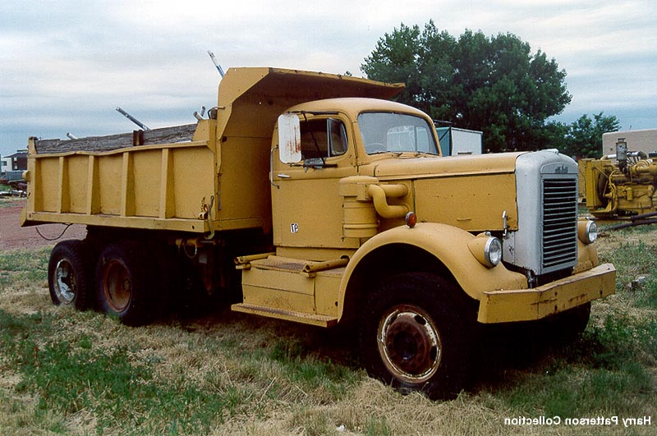

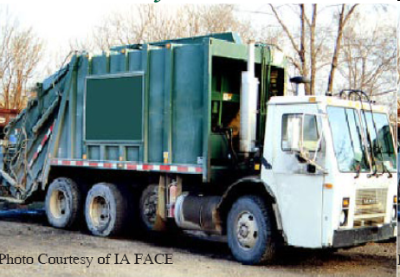
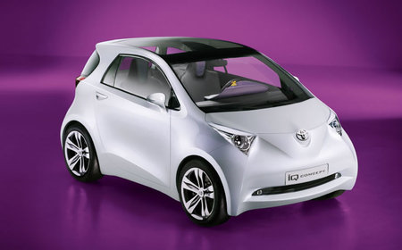
Our Reaction is Kind of Like This:
Imagine a bug…
flying very fast…
and there’s a garbage truck sitting there…
that our bug crashes into!!!
Oddly enough, a
dump truck & small
electric car appear
in its wake…
And they drive off into the sunset!
Make
Sense!?

Slide 3
MINERυA’s Principle Interaction
Of Interest (What we see)
ν_{μ-} + n⁰ → p⁺ + μ⁻
p⁺
υ_{μ−}
n⁰
μ⁻

Slide 4
MINERυA’s Principle Interaction
Of Interest (Revealed)
neutrino + neutron → proton + muon
ν_{μ-} + n⁰ → p⁺ + μ⁻
p⁺
υ_{μ−}
n⁰
μ⁻
Scintillating Target Material

Slide 5
What’s Going On?
A neutrino with kinetic energy strikes a neutron at ‘rest’ in the nucleus of an atom…
Which causes one of the neutron’s down quarks to flip “up” (udd) to (uud)…
the neutron has changed into a proton!
p⁺
υ_{μ−}
n⁰
μ⁻
Scintillating Target Material

Slide 6
What’s Going On?
p⁺
υ_{μ−}
n⁰
μ⁻
Simultaneously, a muon is generated as the original neutrino annihilates…
There is a net gain of mass & a loss of energy during the interaction (E = Δmc²)…
Some of the neutrino’s pre-collision kinetic energy changes into new mass (the muon) and some is transferred to the initial kinetic energies of the muon and proton.

Slide 7
MINERυA’s Principle Interaction
Of Interest (Revealed)
neutrino + neutron → proton + muon
ν_{μ-} + n⁰ → p⁺ + μ⁻
p⁺
υ_{μ−}
n⁰
μ⁻
Scintillating Target Material

Slide 8
Important Momentum Ideas
At the position and time of the interaction only!
p⁺
υ_{μ−}
n⁰
μ⁻
Before Collision
After Collision
p_{neutrino} + p_{neutron} = p_{proton} + p_{muon}

Slide 9
Important Momentum Ideas
The beam is aimed so that neutrinos only have momentum in the z-axis!
p⁺
υ_{μ−}
n⁰
μ⁻
p_{neutrino} + p_{neutron} = p_{proton} + p_{muon}
In the z-axis: p_{neutrino} = p_{proton} + p_{muon}
In the x-axis: 0 = p_{proton} + p_{muon}
In the y-axis: 0 = p_{proton} + p_{muon}

Slide 10
Momentum Ideas Summary
p⁺
υ_{μ−}
n⁰
μ⁻
When the target neutron is totally at rest…
z-axis: p_{neutrino} = p_{proton} + p_{muon}
x and y-axis: 0 = p_{proton} + p_{muon}
If the sum of the x or y axis momenta is not zero, then you have evidence of neutron motion!

